Slide 1

PERFORMING DATA ANALYTICS USING SPREADSHEET SOFTWARE
Formulae • Functions • Logical Operations • Visualization
Computational Thinking

Slide 2
What is data analytics?
Data Analytics is the process of examining raw data to discover useful information, patterns, and insights.
It helps in decision-making, identifying trends, and predicting future outcomes.
In simple terms: turning data into knowledge.
Data analyst collects, cleans, interprets, and analyzes data to uncover trends and provide actionable insights that help businesses make informed decisions

Slide 3
Why Spreadsheets are Powerful for Analytics?
Simple: Easy to learn and use, even for beginners with no coding background.
Accessible: Available in common tools like MS Excel, Google Sheets, LibreOffice which are widely used across industries.
Flexible: Can handle numbers, text, dates, and even visualizations in one place.
Built-in Functions: Ready-made formulas (SUM, AVERAGE, VLOOKUP) simplify complex calculations.
Visualization: Instant charts, pivot tables, and conditional formatting for better understanding.
Scalable: Useful for small student datasets as well as large business reports.

Slide 4

Applications of Data Analytics with
Spreadsheets
Education:
Track student marks, attendance, and performance trends.
Identify top performers and students needing help.
Business:
Sales analysis, revenue tracking, and inventory management.
Customer insights and performance dashboards.
Finance:
Budgeting, expense tracking, loan repayment schedules.
Investment analysis and forecasting.
Research:
Data cleaning, organization, and summary statistics.
Visualizing experimental results and trends.

Slide 5

Anatomy of SpreadSheet
Workbook
Row & Column
Tabs → Ribbon → Groups
Cells
Range
Name Box
Formula Box
Operations
Fill handle or auto fill handle (identify pattern and fill)
Edit in the cell & Click on the cell
Clear group → editing
Insert, delete & swap rows and column
Find / replace (Editing)
File → More options → adjust the values

Slide 6
Formulae in Spreadsheets
Formulae are user-defined expressions that perform calculations using cell values.
Always start with an equal sign (=).
Examples
=A1 + B1 → Adds values in A1 and B1
=A1 * 10% → Calculates 10% of the value in A1
Cell Referencing
Relative Reference (A1): Changes when copied to another cell
Absolute Reference ($A$1): Fixed cell reference, does not change when copied
Demo Idea - Enter marks of 5 students
Total marks (e.g., =B2+C2)
Bonus marks (e.g., =C2*5%)

Slide 7
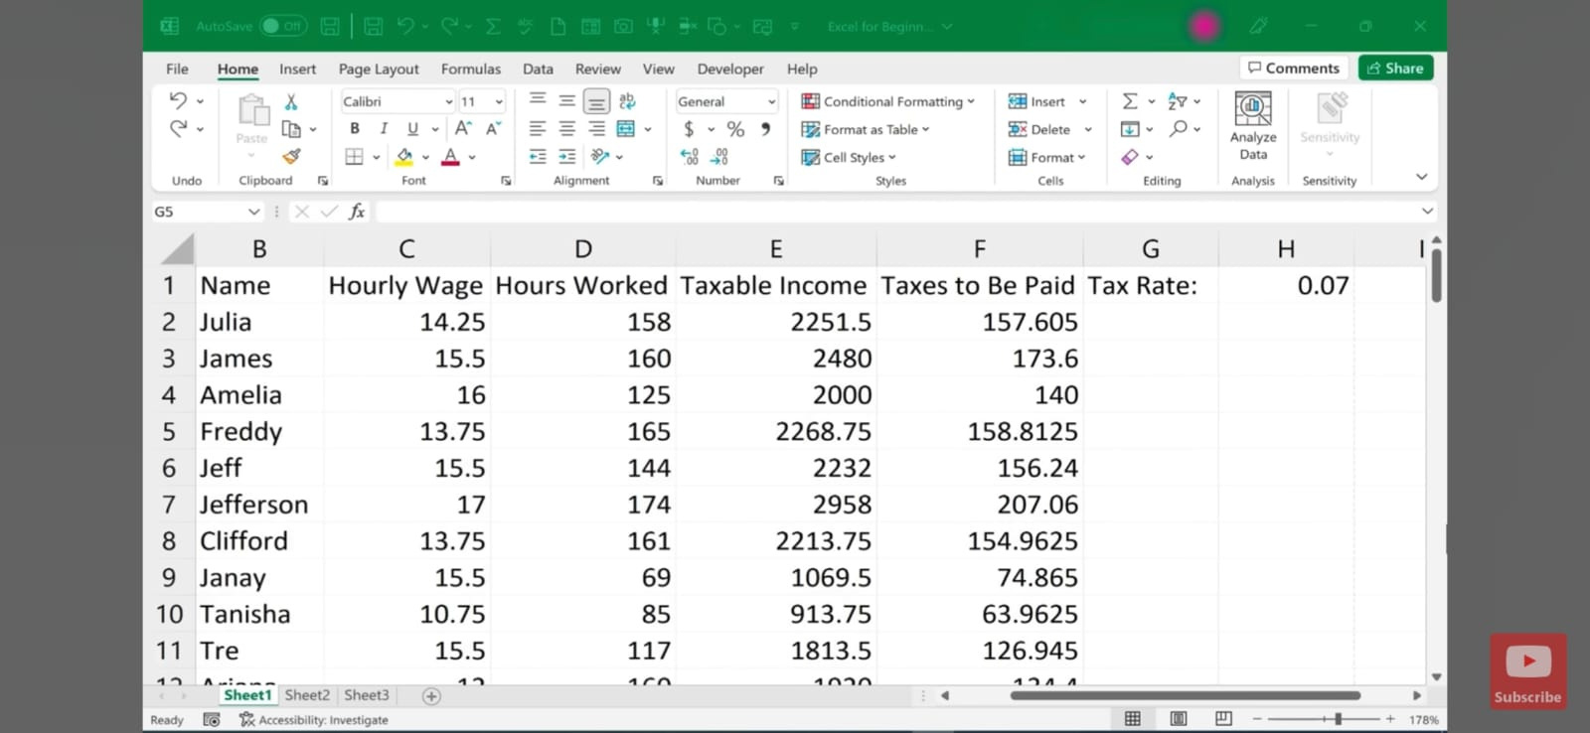

Slide 8
Functions in Spreadsheets
Functions are predefined formulas that perform specific calculations or operations.
They simplify complex tasks into single-step solutions.
Types of Functions
Mathematical:
=SUM(A1:A10) → Adds numbers in a range
=ROUND(B2,2) → Rounds value to 2 decimal places
Statistical:
=AVERAGE(B2:B11) → Finds class average
=MAX(B2:B11) → Highest mark
=MIN(B2:B11) → Lowest mark
=COUNT(D2:D7) → Total count

Slide 9
Functions in Spreadsheets
Text:
=LEN(A2) → Counts characters in a name
=UPPER(A2) → Converts to uppercase
=LEFT(A2,3) → Extracts first 3 characters
Lookup & Reference:
=VLOOKUP(ID,Table,2,FALSE) → Finds student’s mark by ID
=INDEX(A1:C10,2,3) → Returns value from 2nd row, 3rd column
=MATCH(50,B2:B11,0) → Finds position of value 50 in range
Demo Idea - Enter student marks in a column
Use =AVERAGE(B2:B11) to calculate the class average
Highlight highest (MAX) and lowest (MIN) scores

Slide 10
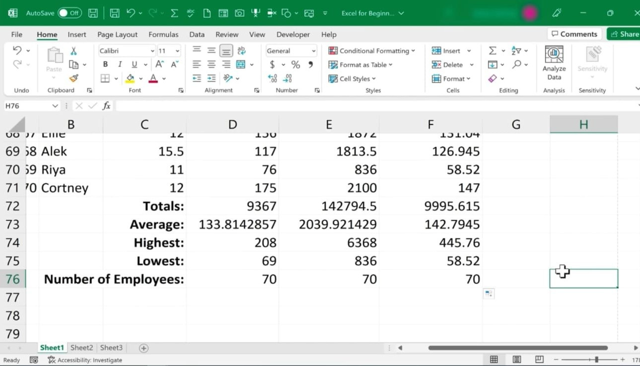


Slide 11
Formatting is the process of changing the appearance of data to make it clear, readable & visually appealing.
It does not change the actual values, only how they are displayed.
Types of Formatting
Text Formatting
Font type, size, bold, italics, underline & Alignment: left, right, center
Number Formatting
Display as currency, percentage, decimal, date, or time
Example: 75 → 75% or 5000 → ₹5,000
Home tab → number group → select currency/number option
Cell Formatting
Borders and shading (background color)
Merging cells for titles
Adjusting column width and row height
Conditional Formatting
Automatically highlight cells based on rules
Example: marks below 40 → red fill, above 80 → green fill
Formatting Content

Slide 12
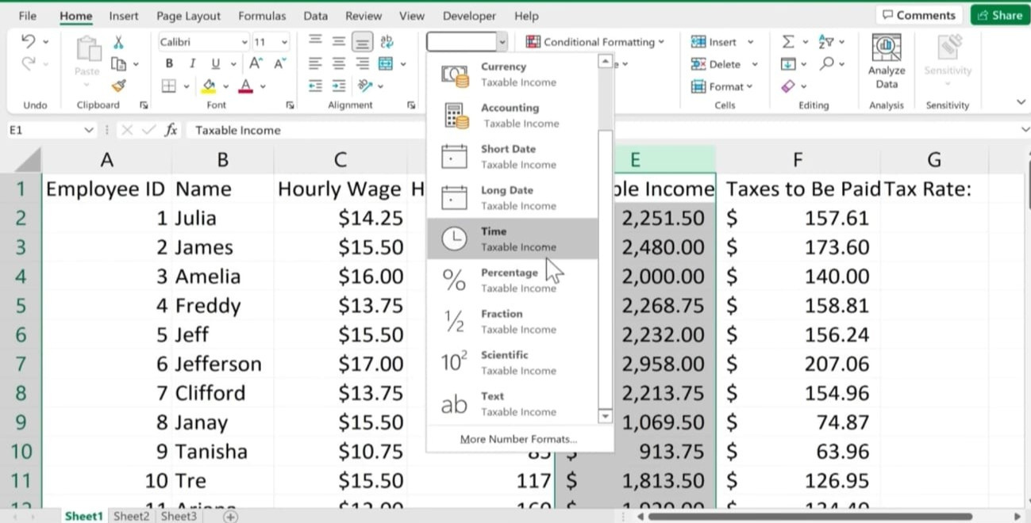

Slide 13
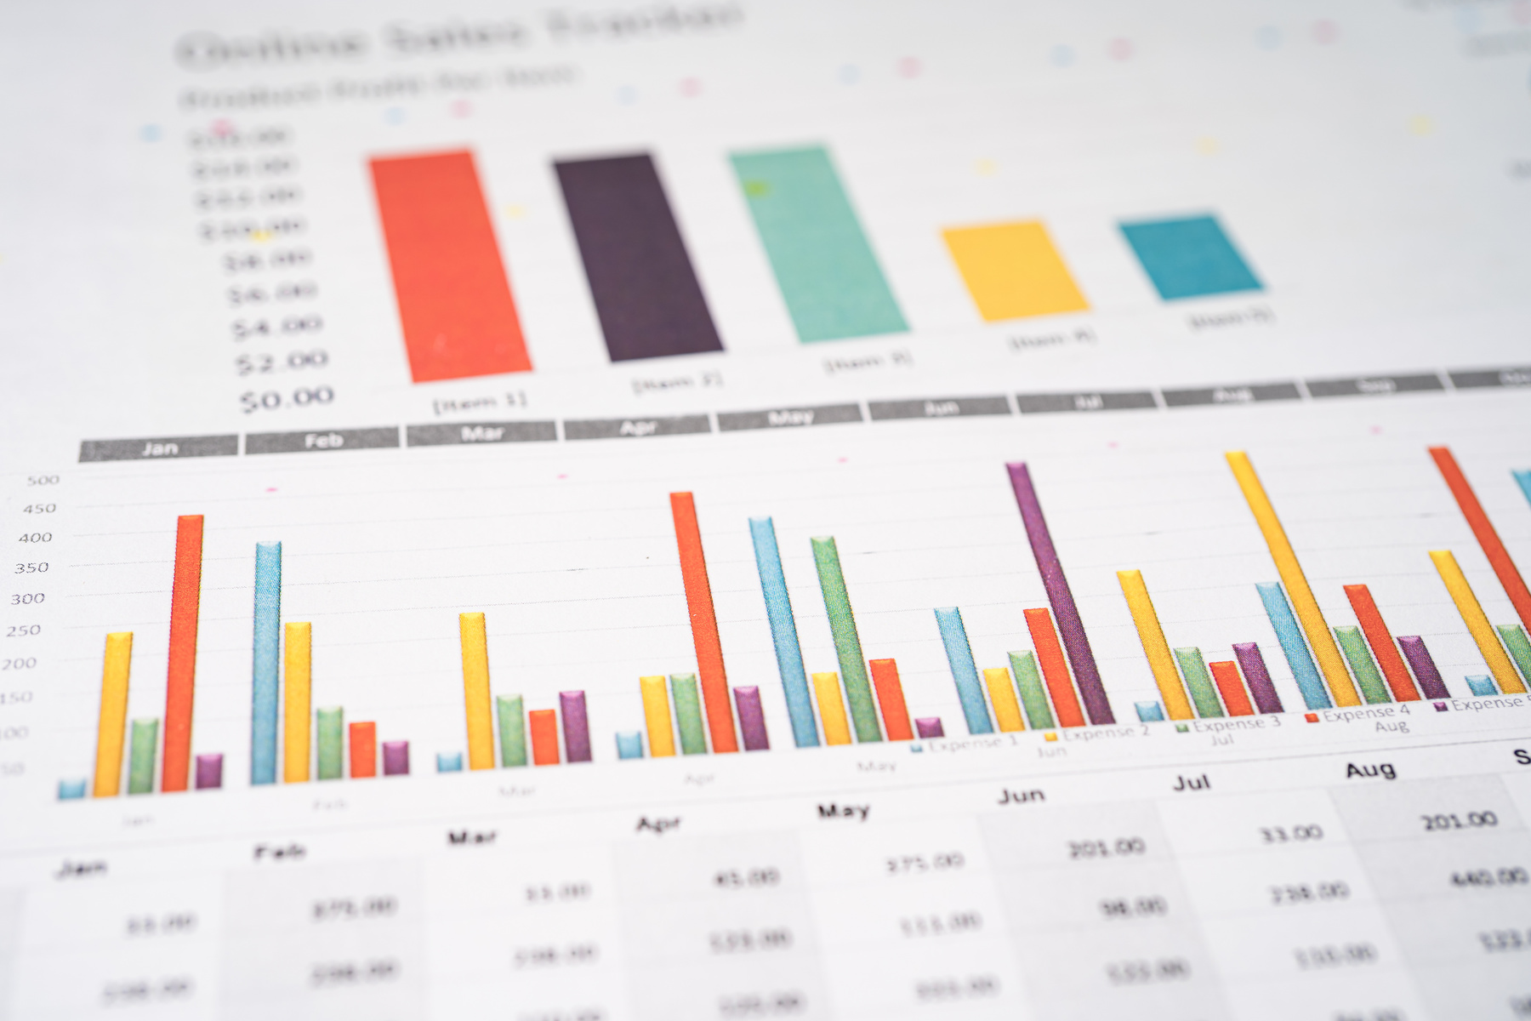
Visualization in Spreadsheets
Why Visualization is Important?
To see patterns and trends hidden in raw numbers.
Makes complex data easy to understand at glance.
Supports better decision-making with visual insights.
For presentations and reports where clarity matters.
Tools in Spreadsheets
Charts
Bar/Column Chart → Compare marks or sales
Line Chart → Show trends over time (e.g., monthly growth)
Pie Chart → Show percentage contribution (e.g., subject-wise performance)
Scatter Plot → Show relationships between two variables

Slide 14
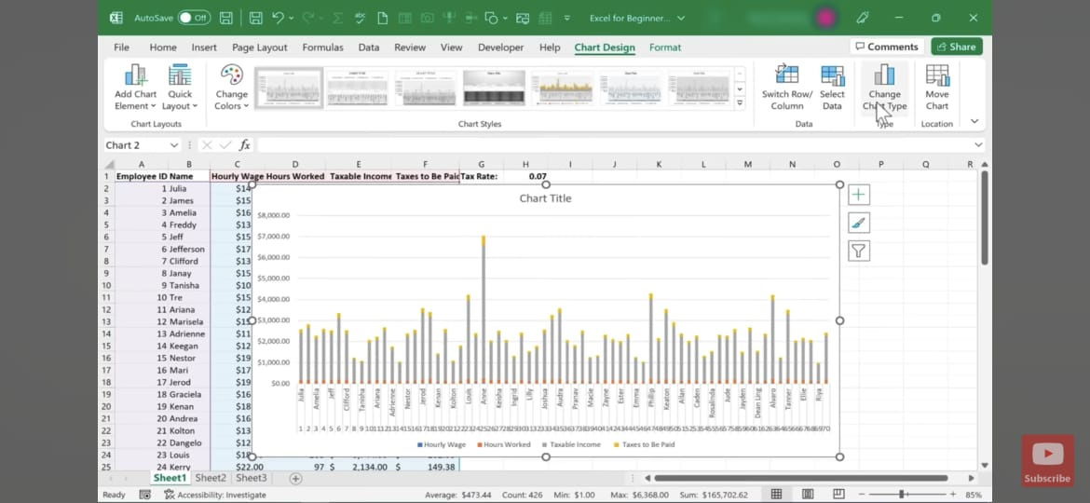

Slide 15
Tools in Spreadsheets
Charts
Bar/Column Chart → Compare marks or sales
Line Chart → Show trends over time (e.g., monthly growth)
Pie Chart → Show percentage contribution (e.g., subject-wise performance)
Scatter Plot → Show relationships between two variables
Pivot Tables
Summarize large datasets
Example: Average marks per subject, sales per region
Conditional Formatting
Highlight values dynamically with colors/icons
Example: Heatmap to show high vs low scores

Slide 16
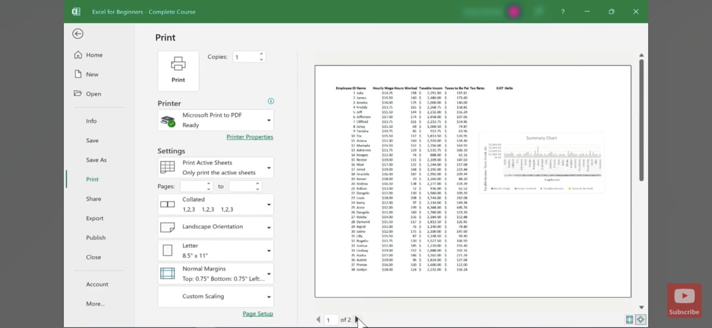
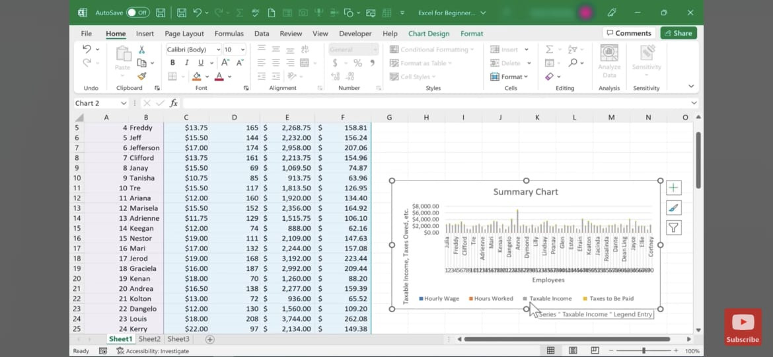


Slide 17
PivotTable
PivotTable is a functionality in Excel which helps you organize and analyze data.
The data that you use needs to be in tabular format.
How a PivotTable Works?
Select Data Range – Highlight the dataset you want to analyze.
Go to Insert → PivotTable.
Choose Location – Select where to place the PivotTable (new or existing sheet).
PivotTable Fields Pane – Drag and drop fields into areas:
Rows → for categories
Columns → for subcategories
Values → for numerical data (e.g., Sum, Count)
Filters → to filter data dynamically

Slide 18
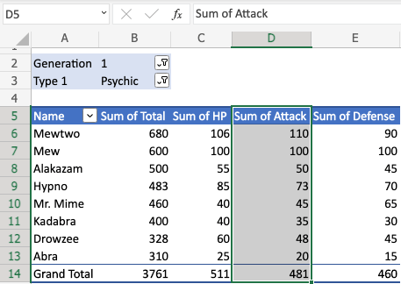
PivotTables have four main components:
Columns
Columns are vertical tabular data.
The column includes the unique header, which is on the top.
The header defines which data you are seeing listed downwards.
In this example,
D5(Sum of Attack) is the header.
D6(110), D7(100), D8(50), D9(73) and more.

Slide 19
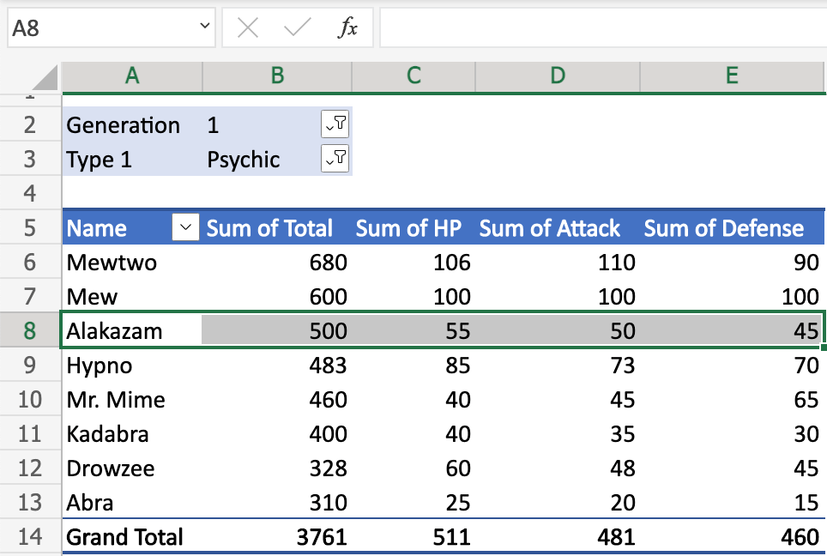
Rows
Rows are horizontal tabular data.
Data in the same row are related.
In this example,
A8(Alakazam) is the Pokemon name.
B8(500), C8(55), D8(50), E8(45) represents the pokemons stats.
The type of stats is read in the header in the columns.

Slide 20
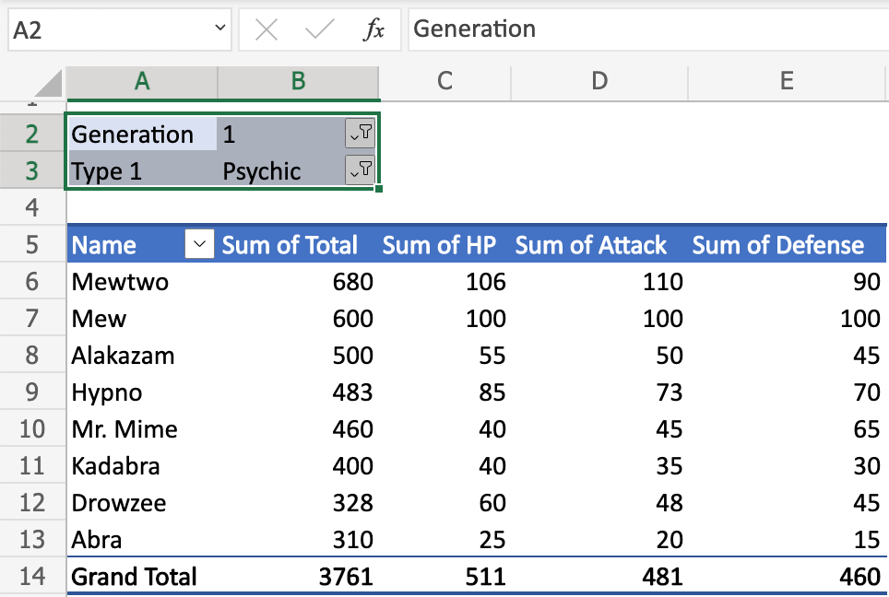
Filters
Filters in PivotTables allow you to display only the specific data you want to analyze by including or excluding certain values.
They help narrow down large datasets, making reports more focused and easier to interpret.

Slide 21
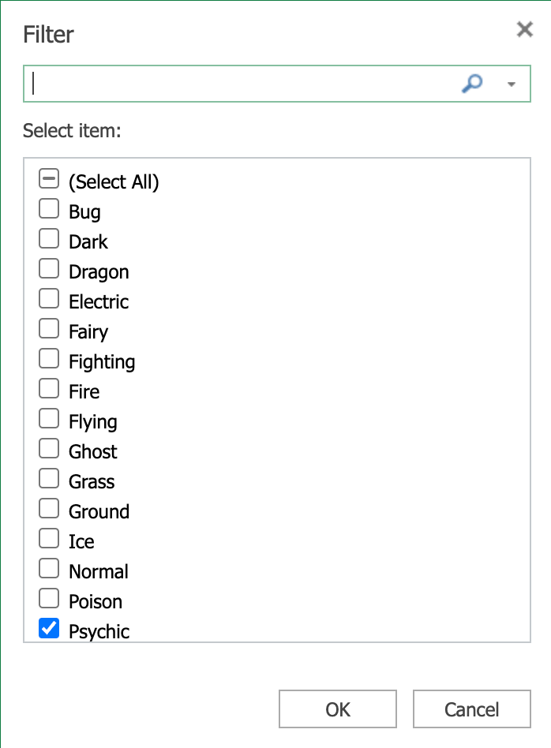
Filter view:
In this example,
There are two filters enabled: Generation and Type 1.
The filters are set to Generation (1) and Type (Psychic).
We will only see Generation 1 pokemon that is Type 1, Psychic.
All pokemon in the table below the filter are of this generation and type.

Slide 22
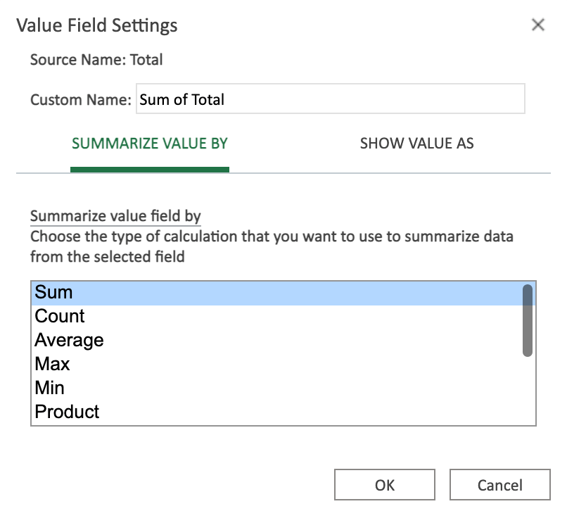
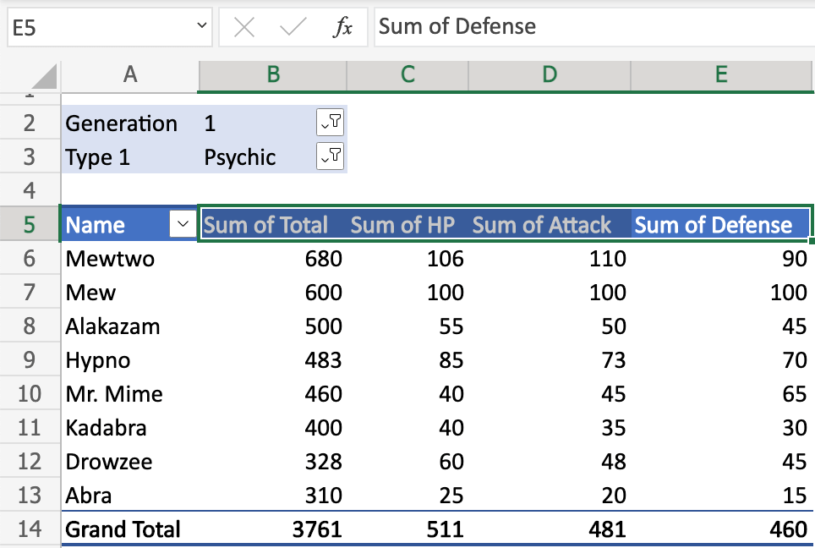
Values: define how you present the data, how Summarize & Show values.
In this example, values are defined for the range B5:E5.
The range B5:E5 has all the same value setting: Sum
The Sum is summarized in the range B14:E14.

Slide 23
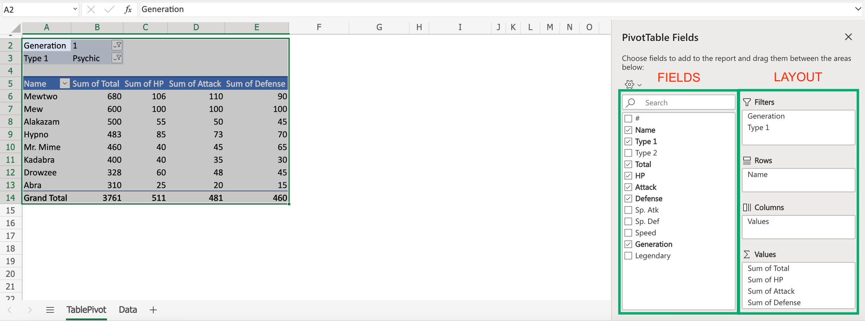
Fields and layout
The TablePivot is displayed how by your settings.
The PivotTable Fields panel is used to change how you see the data.
The settings can be separated in two: Fields and Layout.

Slide 24
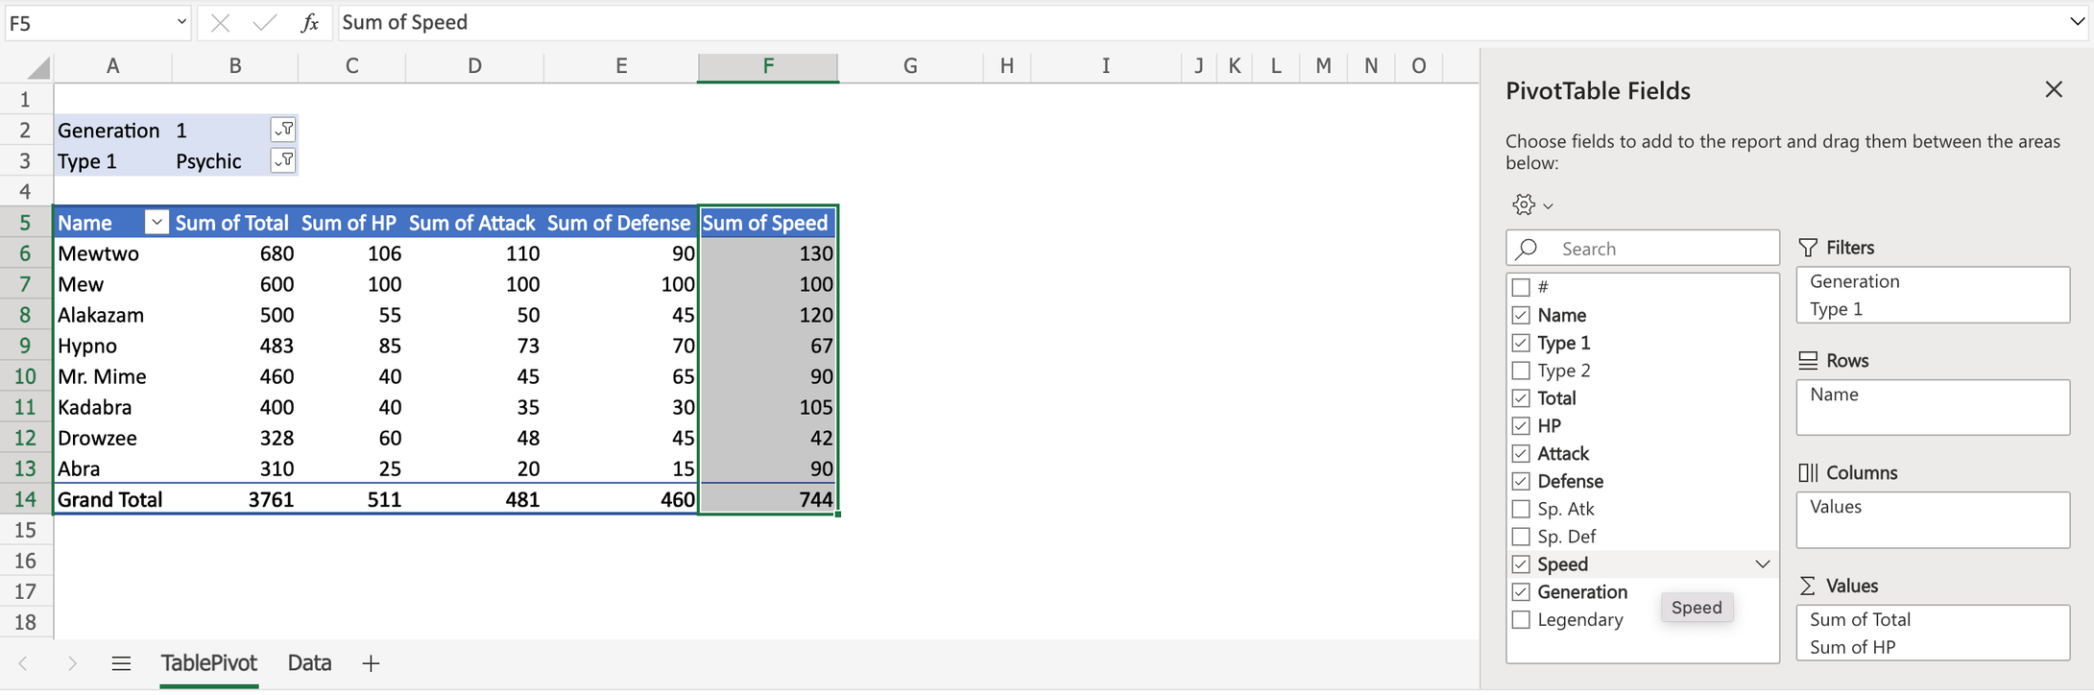
Fields :
The checkboxes can be selected or unselected to display or change property of the data.
In this example, the checkbox for Speed is selected.
Speed is now displayed in the table.

Slide 25
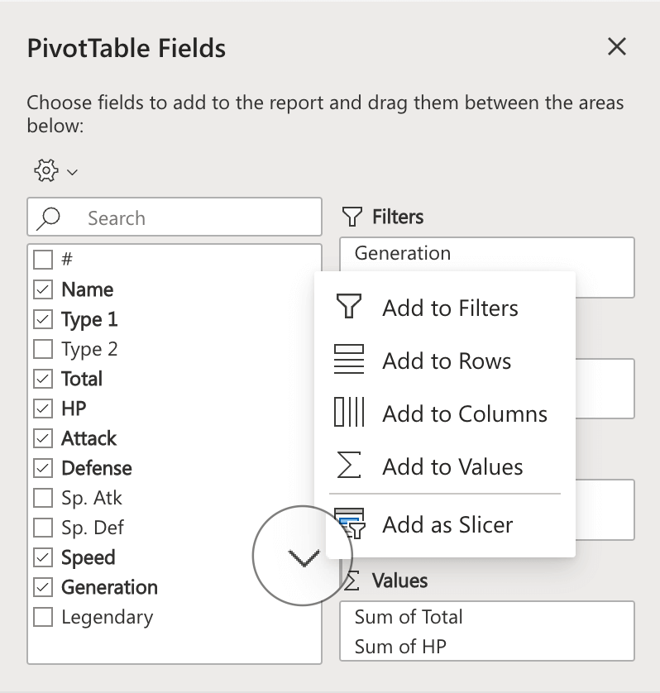
You can click the downwards arrow to change how the data is presented.

Slide 26
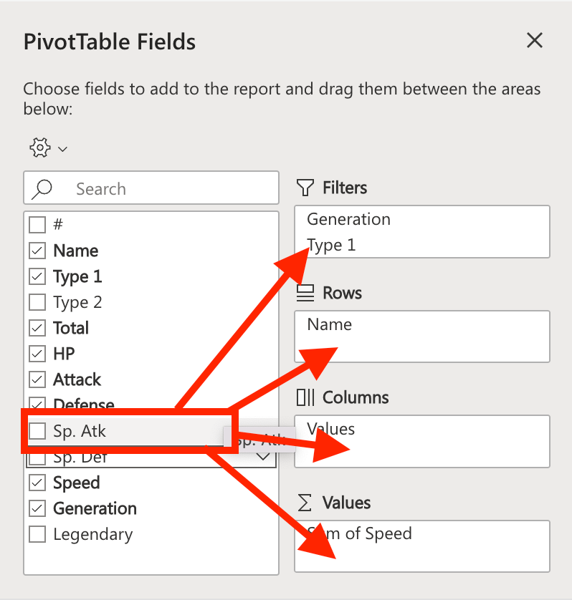
Layout:
Drag and drop fields to the boxes to the right to display data in the table.
Four main components:
Filters
Rows
Columns
Values

Slide 27
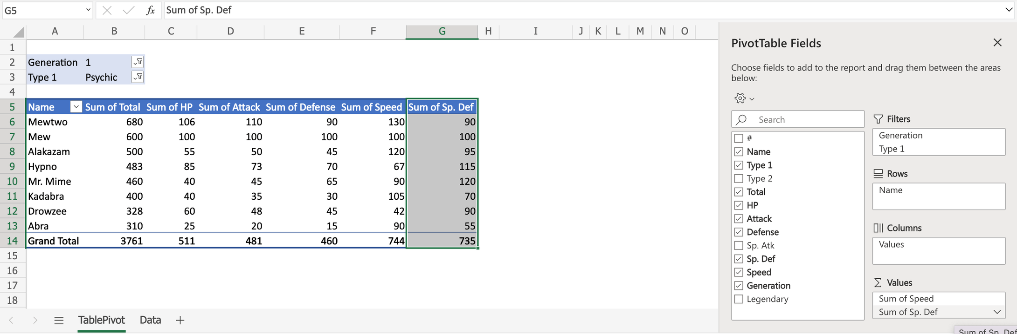
In this example, we will drag and drop Sp. def to Values.

Slide 28
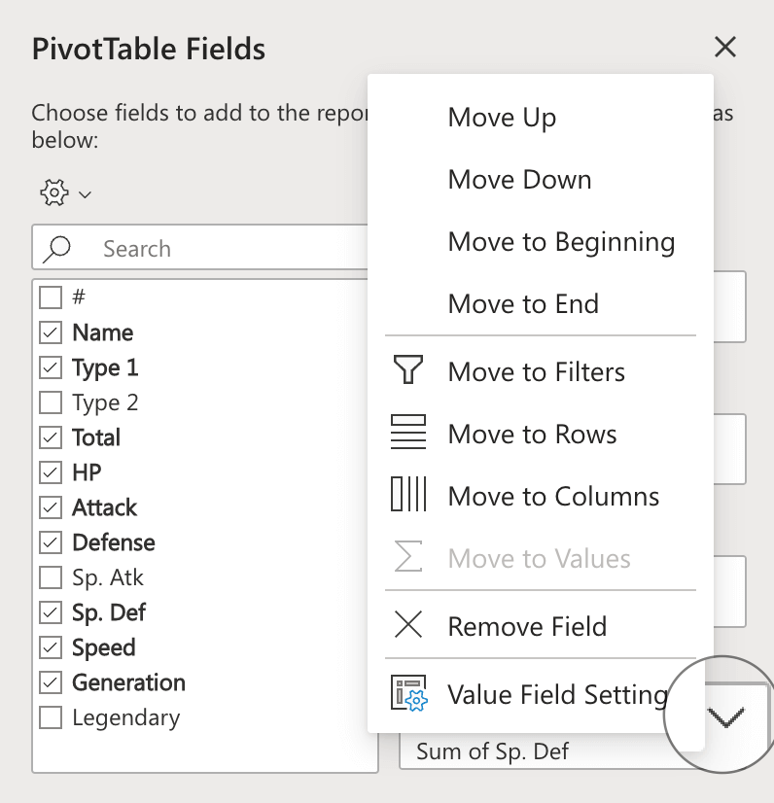
Sp. Def is now displayed in the table.
The settings of the fields that you have moved to the right side can be changed.
Click the downwards arrow to access the settings.
This is possible in the four areas (Filters, rows, columns and, values).

Slide 29
THANK YOU

